Slide 1
WELCOME

Slide 2
IDENTITY
TEACHER
LESSON
MD.AINUL HAQUE
ASSISTANT TEACHER
SORUGRAM GPS
DHUNAT, BOGRA
CLASS:FIVE
SUBJECT:ENGLISH
LESSON:1-2
UNIT:19(On 14---war)

Slide 3
LEARNING OUTCOMES
At the end of the lesson students will be able to-
4.2.1 Understand and enjoy simple stories
3.1.1Ask and answer with questions
5.1.2Read silently with understanding stories
10.1.1Write a short piece of composition by answering a set of questions

Slide 4
LETS WATCH A PICTURE

Slide 5
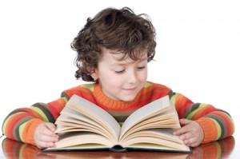
TODAY`S LESSON
THE LIBERATION WAR MUSEUM

Slide 6
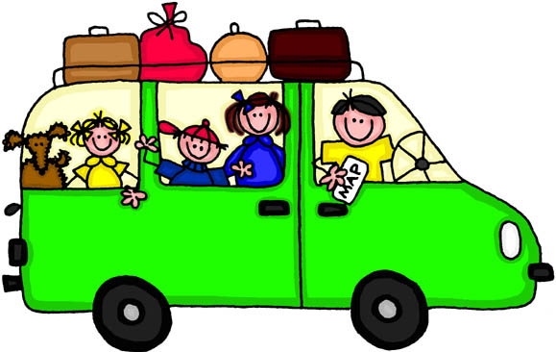
New words and meaning
TRIP
An excursion for pleasure

Slide 7
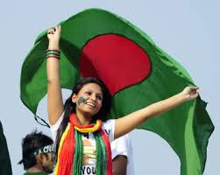
LIBERATION
The act of making one free

Slide 8
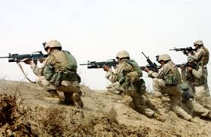
War
Armed fighting

Slide 9
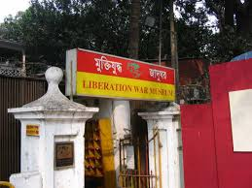
Museum
A building in which objects of historical are kept

Slide 10
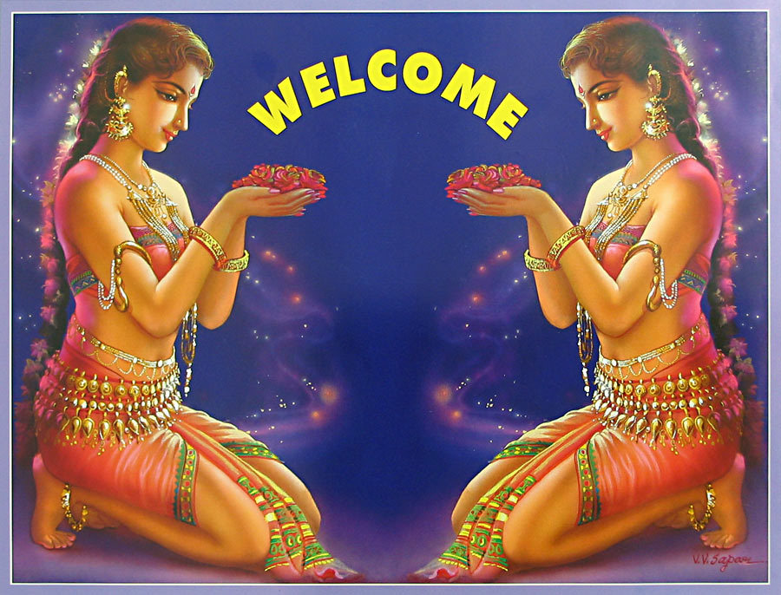
WELCOME
To greet in a polite way

Slide 11
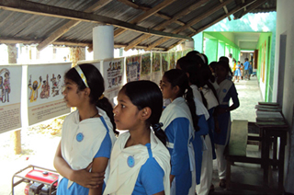
On 14 December, our class went on a field trip to the Liberation War Museum at Segunbagicha, Dhaka.

Slide 12
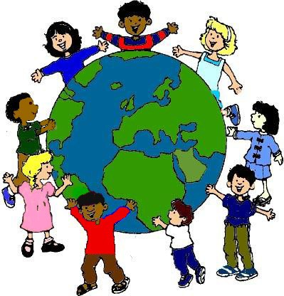
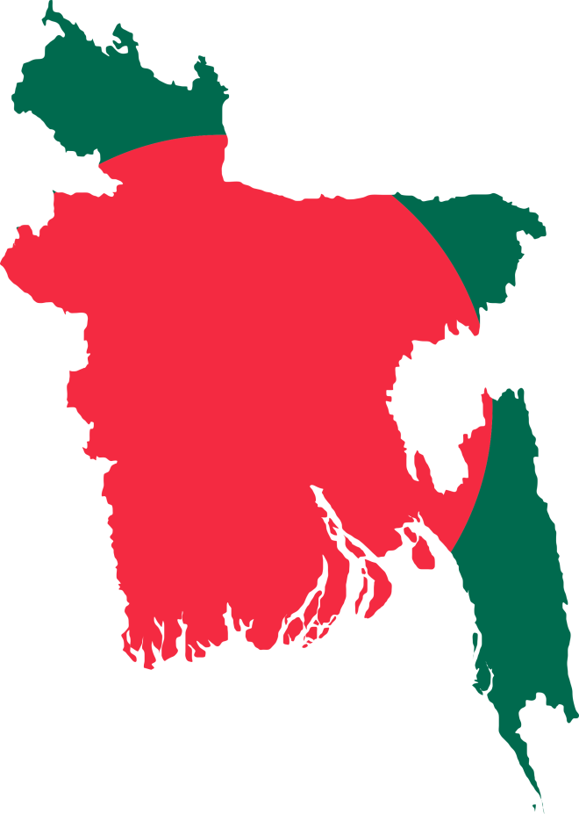
The trip was planned as a part of our Bangladesh and GlobalStudies course.

Slide 13
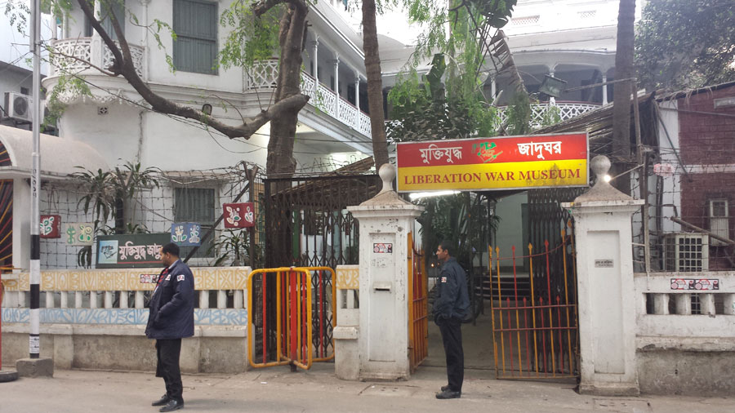
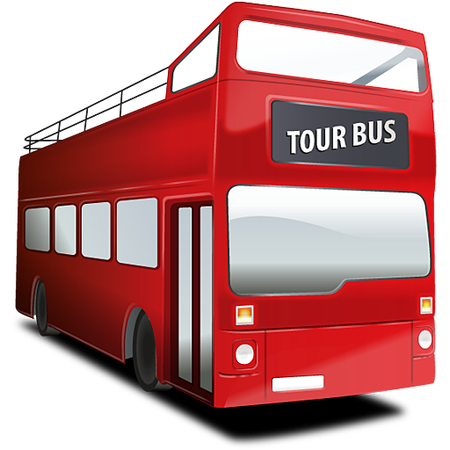
Our bus reached the museum at10 a. m.

Slide 14
A guide was waiting for us
A guide was waiting for us

Slide 15
He welcomed us warmly and took us
on a quick tour of the different Galleries and exhibits of the museum.

Slide 16
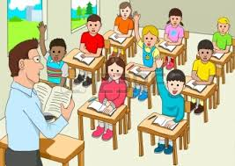
TEACHER’S MODEL READING

Slide 17
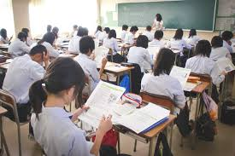
WHOLE CLASS READING

Slide 18
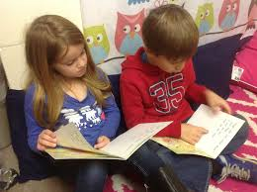
SS -PAIR READING

Slide 19
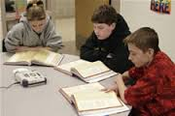
SS-SILENT READING

Slide 20
GROUP WORK
Discuss in group and answer the following questions:
When did the class go to the Liberation War museum?
How did they go there?
Why did the class go to Liberation War Museum?

Slide 21
Work in pair
Fill in the blanks:
Our class went to a -
Our bus reached the museum at -
A guide was –for us

Slide 22
Evaluation
Who is the writer of Sunshine Magazine?
Where is Liberation War Museum?
Who was waiting for us?

Slide 23
TASK
Write five sentences about Liberation War of 1971 by using following cues:
Liberation,war,museum,independent,exhibit

Slide 24
THANKS

